Slide 1
Unification Forward chaining & backward chaining

Slide 2

PROPOSITIONAL VS. FIRST-ORDER INFERENCE
Inference rules for quantifiers
Suppose axiom stating that all greedy kings are evil:
∀ x King(x) ∧ Greedy(x) ⇒ Evil(x) .
Then it seems quite permissible to infer any of the following sentences:
King(John) ∧ Greedy(John) ⇒ Evil(John)
King(Richard ) ∧ Greedy(Richard) ⇒ Evil(Richard)
King(Father (John)) ∧ Greedy(Father (John)) ⇒ Evil(Father (John)) .
...
The rule of Universal Instantiation (UI for short) says that we can infer any sentence obtained by substituting a ground term (a term without variables) for the variable.
To write out the inference rule formally, we use the notion of substitutions. Let SUBST(θ,α) denote the result of applying the substitution θ to the sentence α. Then the rule is written
for any variable v and ground term g. For example, the three sentences given earlier are obtained with the substitutions {x/John}, {x/Richard }, and {x/Father (John)}.

Slide 3

In the rule for Existential Instantiation, the variable is replaced by a single new constant symbol. The formal statement is as follows: for any sentence α, variable v, and constant symbol k that does not appear elsewhere in the knowledge base,
For example, from the sentence
∃ x Crown(x) ∧ OnHead(x, John)
we can infer the sentence
Crown(C1) ∧ OnHead(C1, John)
as long as C1 does not appear elsewhere in the knowledge base.
Basically, the existential sentence says there is some object satisfying a condition, and applying the existential instantiation rule just gives a name to that object.
Whereas Universal Instantiation can be applied many times to produce many different consequences, Existential Instantiation can be applied once, and then the existentially quantified sentence can be discarded

Slide 4
Unification
Unification is a process that require finding substitutions that make different logical expressions look identical. The UNIFY algorithm takes two sentences and returns a unifier for them if one exists
Unification is a process of making two different logical atomic expressions identical by finding a substitution.
Unification depends on the substitution process.
Let Ψ₁ and Ψ₂ be two atomic sentences and 𝜎 be a unifier such that, Ψ₁𝜎 = Ψ₂𝜎, then it can be expressed as UNIFY(Ψ₁, Ψ₂).
Example: Unify{King(x), King(John)}
Let Ψ₁ = King(x), Ψ₂ = King(John),
Substitution θ = {x/John} is a unifier for these atoms and applying this substitution, and both expressions will be identical.

Slide 5
Let's say there are two different expressions, P(x, y), and P(a, f(z)).
In this example, we need to make both above statements identical to each other. For this, we will perform the substitution.
P(x, y) and P(a, f(z))
Substitute x with a, and y with f(z) in the first expression, and it will be represented as x/a and y/f(z).
With both the substitutions, the first expression will be identical to the second expression and the substitution set will be: [x/a, y/f(z)].

Slide 6
Suppose we have a query AskVars(Knows(John, x)): whom does John know? Answers to this query can be found by finding all sentences in the knowledge base that unify with Knows(John, x). Here are the results of unification with four different sentences that might be in the knowledge base:
UNIFY(Knows(John, x), Knows(John, Jane)) = {x/Jane}
UNIFY(Knows(John, x), Knows(y, Bill )) = {x/Bill, y/John}

Slide 7
UNIFY(Knows(John, x), Knows(y,Mother (y))) = {y/John, x/Mother (John)}
UNIFY(Knows(John, x), Knows(x, Elizabeth)) = fail .
The last unification fails because x cannot take on the values John and Elizabeth at the same time. Now, remember that Knows(x, Elizabeth) means “Everyone knows Elizabeth,” so we should be able to infer that John knows Elizabeth. The problem arises only because the two sentences happen to use the same variable name, x.

Slide 8
Following are some basic conditions for unification:
Predicate symbol must be same, atoms or expression with different predicate symbol can never be unified.
Number of Arguments in both expressions must be identical.
Unification will fail if there are two similar variables present in the same expression.

Slide 9
Example
UNIFY{p(f(a), g(Y)) and p(X, X)}
Sol: S₀ => Here, Ψ₁ = p(f(a), g(Y)), and Ψ₂ = p(X, X) SUBST θ= {X/f(a)} S1 => Ψ₁ = p(f(a), g(Y)), and Ψ₂ = p(f(a), f(a)) SUBST θ= {g(y)/f(a)}, Unification failed.
Unification is not possible for these expressions.

Slide 10
UNIFY{p(b, X, f(g(Z))) and p(Z, f(Y), f(Y))}
Here, Ψ₁ = p(b, X, f(g(Z))) , and Ψ₂ = p(Z, f(Y), f(Y)) S₀ => { p(b, X, f(g(Z))); p(Z, f(Y), f(Y))} SUBST θ={Z/B}
S₁ => { p(b, X, f(g(b))); p(b, f(Y), f(Y))} SUBST θ={X/f(Y)}
S₂ => { p(b, f(Y), f(g(b))); p(b, f(Y), f(Y))} SUBST θ= {Y/g(b)}
S₂ => { p(b, f(g(b)), f(g(b)); p(b, f(g(b)), f(g(b))}
Unified Successfully. And Unifier = { b/Z, f(Y) /X , g(b) /Y}.

Slide 11
UNIFFY {p (X, X), and p (Z, f(Z))}
Here, Ψ₁ = {p (X, X), and Ψ₂ = p (Z, f(Z)) S₀ => {p (X, X), p (Z, f(Z))} SUBST θ= {Z/X} S1 => {p (Z, Z), p (Z, f(Z))} SUBST θ= {Z/f(Z)}, Unification Failed.
Hence, unification is not possible for these expressions.
UNIFY(prime (11), prime(y))
Here, Ψ₁ = {prime(11) , and Ψ₂ = prime(y)} S₀ => {prime(11) , prime(y)} SUBST θ= {Y/11}
S₁ => {prime(11) , prime(11)} , Successfully unified. Unifier: {Y/11}.

Slide 12
UNIFY Q(a, g(x, a), f(y)), Q(a, g(f(b), a), x)}
Here, Ψ₁ = Q(a, g(x, a), f(y)), and Ψ₂ = Q(a, g(f(b), a), x) S₀ => {Q(a, g(x, a), f(y)); Q(a, g(f(b), a), x)} SUBST θ= {x/f(b)} S₁ => {Q(a, g(f(b), a), f(y)); Q(a, g(f(b), a), f(b))}
SUBST θ= {y/b} S₁ => {Q(a, g(f(b), a), f(b)); Q(a, g(f(b), a), f(b))}, Successfully Unified.
Unifier: [a/a, x/f(b), y/b].
6. UNIFY(knows(Richard, x), knows(Richard, John))
Here, Ψ₁ = knows(Richard, x), and Ψ₂ = knows(Richard, John) S₀ => { knows(Richard, x); knows(Richard, John)} SUBST θ= {x/John} S₁ => { knows(Richard, John); knows(Richard, John)}, Successfully Unified. Unifier: {x/John}.

Slide 13
FORWARD CHAINING
Forward chaining is also known as a forward deduction or forward reasoning method when using an inference engine. Forward chaining is a form of reasoning which start with atomic sentences in the knowledge base and applies inference rules in the forward direction to extract more data until a goal is reached.
The Forward-chaining algorithm starts from known facts, triggers all rules whose premises are satisfied, and add their conclusion to the known facts. This process repeats until the problem is solved.

Slide 14
Properties of Forward-Chaining:
It is a down-up approach, as it moves from bottom to top.
It is a process of making a conclusion based on known facts or data, by starting from the initial state and reaches the goal state.
Forward-chaining approach is also called as data-driven as we reach to the goal using available data.
Forward -chaining approach is commonly used in the expert system, such as CLIPS, business, and production rule systems.
Example: "The law says that it is a crime for an American to sell weapons to hostile nations. The country A, an enemy of America, has some missiles, and all of its missiles were sold to it by Robert, who is American.“ Prove that "Robert is criminal."
Notes:
C Language Integrated Production System

Slide 15
Facts Conversion into FOL:
It is a crime for an American to sell weapons to hostile nations. (Let's say p, q, and r are variables) American (p) ∧ weapon(q) ∧ sells (p, q, r) ∧ hostile(r) → Criminal(p) ...(1)
Country A has some missiles. Owns(A, p) ∧ Missile(p). It can be written in two definite clauses by using Existential Instantiation, introducing new Constant T1. Owns(A, T1) ......(2) Missile(T1) .......(3)
All of the missiles were sold to country A by Robert. Missile(p) ∧ Owns (A, p) → Sells (Robert, p, A) ......(4)
Missiles are weapons. Missile(p) → Weapons (p) .......(5)
Enemy of America is known as hostile. Enemy(p, America) →Hostile(p) ........(6)
Country A is an enemy of America. Enemy (A, America) .........(7)
Robert is American American(Robert). ..........(8)

Slide 16

Forward chaining proof:
Step-1:In the first step we will start with the known facts and will choose the sentences which do not have implications, such as: American(Robert), Enemy(A, America), Owns(A, T1), and Missile(T1). All these facts will be represented as below.

Slide 17
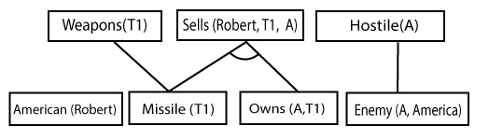
Step-2: At the second step, we will see those facts which infer from available facts and with satisfied premises.
Rule-(1) does not satisfy premises, so it will not be added in the first iteration.
Rule-(2) and (3) are already added.
Rule-(4) satisfy with the substitution {p/T1}, so Sells (Robert, T1, A) is added, which infers from the conjunction of Rule (2) and (3).
Rule-(6) is satisfied with the substitution(p/A), so Hostile(A) is added and which infers from Rule-(7).

Slide 18
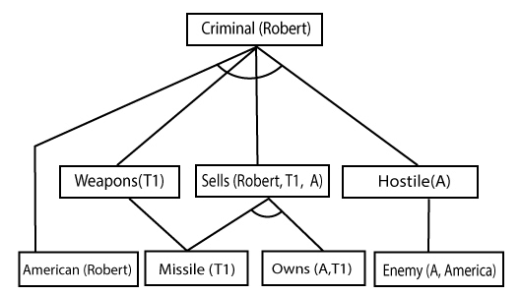
Step-3: At step-3, as we can check Rule-(1) is satisfied with the substitution {p/Robert, q/T1, r/A}, so we can add Criminal(Robert) which infers all the available facts. And hence we reached our goal statement.

Slide 19
Backward Chaining:
Backward-chaining is also known as a backward deduction or backward reasoning method when using an inference engine. A backward chaining algorithm is a form of reasoning, which starts with the goal and works backward, chaining through rules to find known facts that support the goal.
Properties of backward chaining:
It is known as a top-down approach.
In backward chaining, the goal is broken into sub-goal or sub-goals to prove the facts true.
It is called a goal-driven approach, as a list of goals decides which rules are selected and used.
Backward -chaining algorithm is used in game theory, automated theorem proving tools, inference engines, proof assistants, and various AI applications.

Slide 20
In backward-chaining, rewrite all the rules.
American (p) ∧ weapon(q) ∧ sells (p, q, r) ∧ hostile(r) → Criminal(p) ...(1) Owns(A, T1) ........(2)
Missile(T1) ……….(3)
Missiles(p) ∧ Owns (A, p) → Sells (Robert, p, A) ......(4)
Missile(p) → Weapons (p) .......(5)
Enemy(p, America) →Hostile(p) ........(6)
Enemy (A, America) .........(7)
American(Robert). ..........(8)

Slide 21

Backward-Chaining proof:
In Backward chaining, we will start with our goal predicate, which is Criminal(Robert), and then infer further rules.
Step-1:
At the first step, we will take the goal fact. And from the goal fact, we will infer other facts, and at last, we will prove those facts true. So our goal fact is "Robert is Criminal," so following is the predicate of it.

Slide 22
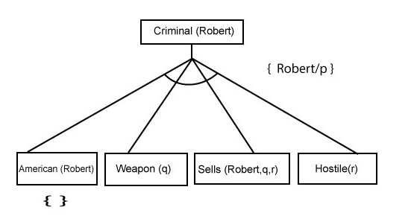
At the second step, we will infer other facts form goal fact which satisfies the rules. So as we can see in Rule-1, the goal predicate Criminal (Robert) is present with substitution {Robert/P}. So we will add all the conjunctive facts below the first level and will replace p with Robert.
Here we can see American (Robert) is a fact, so it is proved here.

Slide 23
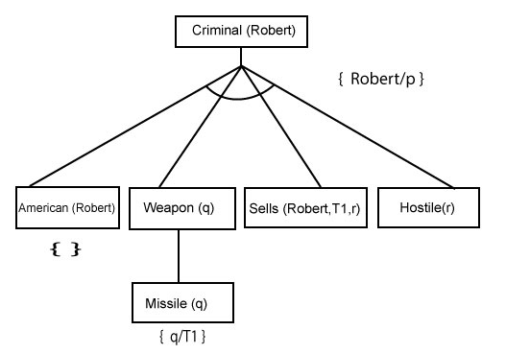
Step-3:t At step-3, we will extract further fact Missile(q) which infer from Weapon(q), as it satisfies Rule-(5). Weapon (q) is also true with the substitution of a constant T1 at q.

Slide 24
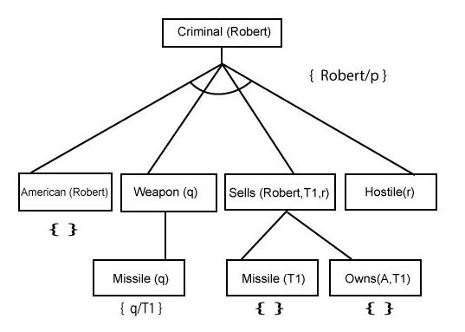
Step-4: At step-4, we can infer facts Missile(T1) and Owns(A, T1) form Sells(Robert, T1, r) which satisfies the Rule- 4, with the substitution of A in place of r. So these two statements are proved here.

Slide 25
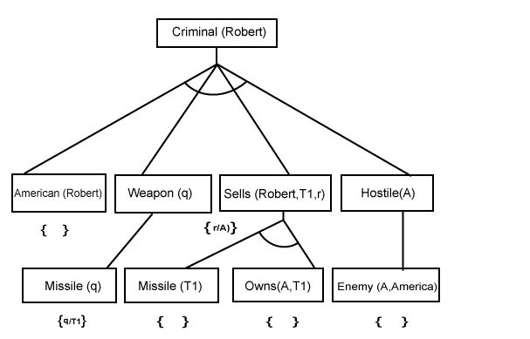
Step-5: At step-5, we can infer the fact Enemy(A, America) from Hostile(A) which satisfies Rule- 6. And hence all the statements are proved true using backward chaining.

